Slide 1
OpenFlow 1.3
Length
Transaction ID
04 00 00 08 6e 3d be f1
OFPT_HELLO

Slide 2
Software Defined Networking
using tools as Mininet, ONOS and Wireshark
Preparation: Your own virtual environment
SDN voor Dummy’s
The SDN Controller: ONOS
Your own network using Mininet
The OpenFlow Protocol
Dynamic Networks

Slide 3
HANDS-ON 0: Je eigen Virtuele Omgeving
You need Virtualbox
Using the workshop material you can create your own virtual environment
For now, available USB’s let you get a prepared environment
Important: Don’t use the KOEN_WLAN network. (KOEN_MOBILE is fine)
Material available: www.github.com/Marlou16/sdn-tutorial

Slide 4
What is Software Defined Networking?
SDN is a way of networking
Intelligence is taken from the traditional network devices and put in a separate layer
The network is being controlled by the ‘SDN controller’ or ‘Network Operating System’
We call it ‘software defined’ because you can add self-written application to the controller, implementing the functionality of the network.

Slide 5
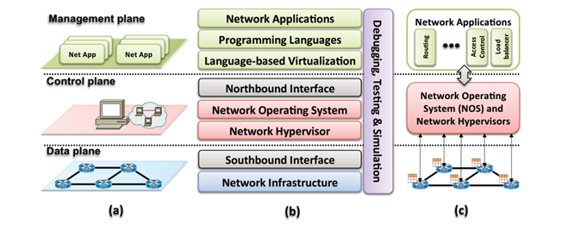
SDN in figures

Slide 6
SDN possibilities
Network devices get ‘simpler’, and cheaper
Network functionality is controller from above
  More insight into the network itself
  Less dependent on the network devices (previously blackboxes)
We can implement our own network functionality
@KPN
Replace the traditional core network for a SDN infrastructure;
The GOVirtual platform also works with SDN in the form of “Nokia Nuage”.

Slide 7
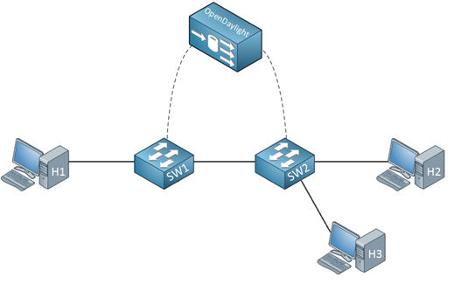
SDN Compontenten (1)
Controller:
Performs network calculations
Sends direct instructions towards switches
Sends flow rules towards switches
Control Channel:
The OpenFlow Protocol
Computer
Forwarding Device:
Checks its flow table for stored instructions it can perform
Contacts the controller
Performs direct instructions from the controller

Slide 8
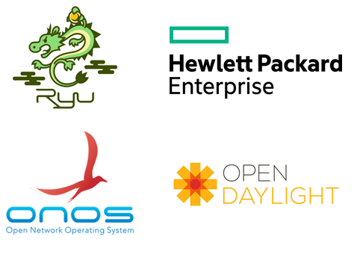


SDN Compontenten (1)

Slide 9
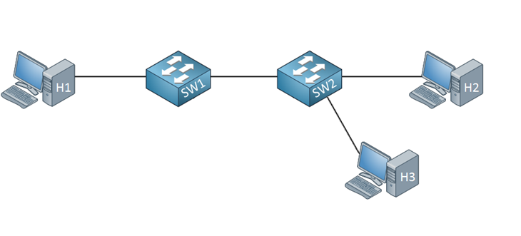
Communication in a traditional network (1)
Let’s say “Hi!” to H2

Slide 10
Communication in a traditional network (2)
I don’t know H2…
Let’s say “Hi!” to H2
I don’t know H2, let’s ask all my friends (flooding)

Slide 11
Communication in a traditional network (3)
Let’s remember this info for next time!
H2, that is me!
Did I win a prize?
I’m not H2, let’s keep my mouth shut.

Slide 12
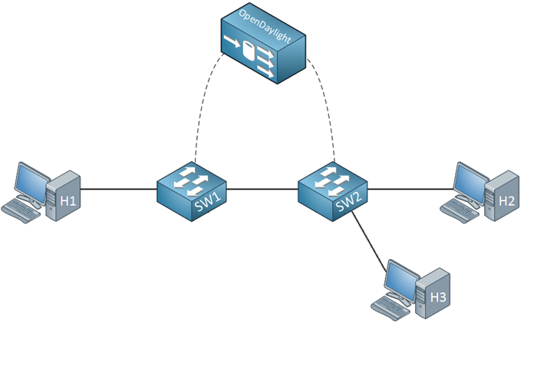
Communication with SDN (1)
I wanted to say “Hi!” to H2…
Can’t find any match,
let’s call for help!

Slide 13
Communication with SDN (2)
I’m still collecting information about the network topology, just flood this message, OK?
PACKET_IN
PACKET_OUT
Just do as you are told..

Slide 14
Communicatie met SDN (3)
I know enough to see what needs to happen. Store this as a flow rule for next time.
FLOW_MOD
Did I win something this time?
PACKET_IN
My flow table is empty…

Slide 15
Communication with SDN (4)
“Hi H2, it is me again!”
1
2
00:00:00:00:00:01
00:00:00:00:00:02
I know what to do now!

Slide 16
HANDS-ON 1: ONOS en Mininet
I give a Demo serving as an example
Using the tuturial, go through:
  Discover ONOS
  Creating your network with Mininet
Material via: www.github.com/Marlou16/sdn-tutorial
(load it on the VM in order to fully be able to ‘copy-paste’)

Slide 17
HANDS-ON 2: OpenFlow met Wireshark
I give a Demo serving as an example
Using the tuturial, go through:
  The OpenFlow Protocol
  Looking at OpenFlow using Wireshark
  (Putting things in context (only reading))
Material via: www.github.com/Marlou16/sdn-tutorial
(load it on the VM in order to fully be able to ‘copy-paste’)

Slide 18
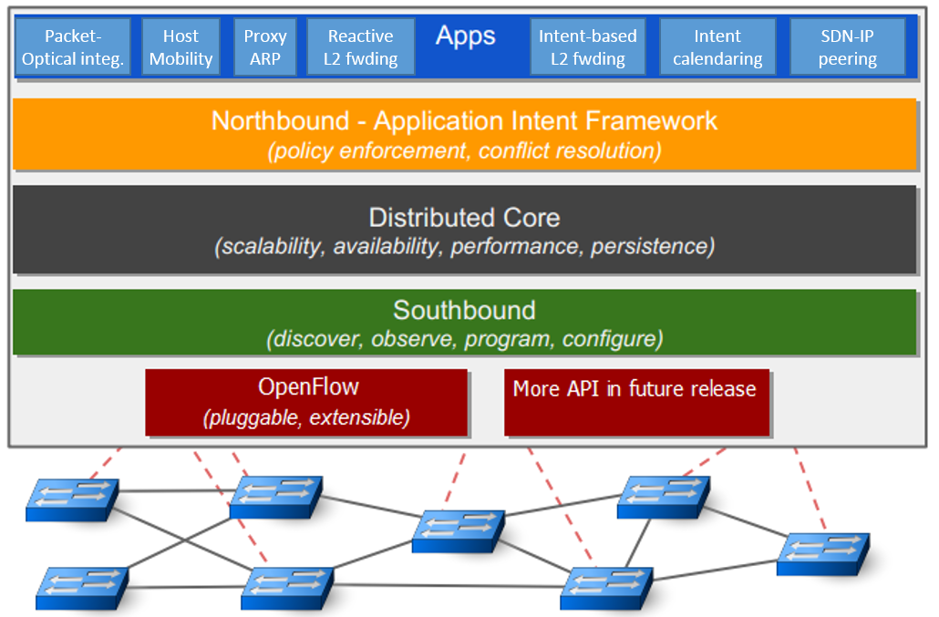
The ONOS controller in context (recap)

Slide 19
HANDS-ON 3: Intent-based Forwarding
I give a Demo serving as an example
  Installation of a new application
  Intent-based Forwarding
  Dynamic Network
Using the tuturial, go through:
  Next-level SDN: Intent-based Forwarding
  (Bonus) “Try it all” opgave
Material via: www.github.com/Marlou16/sdn-tutorial

